Slide 1




Introduction to IMPROVE and Regional Haze Data
WRAP Regional Haze Planning Work Group call - June 29 , 2017
Scott Copeland, CIRA/USDA Forest Service
IMPROVE Steering Committee Chair
scott.copeland@colostate.edu

Slide 2


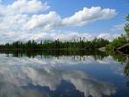
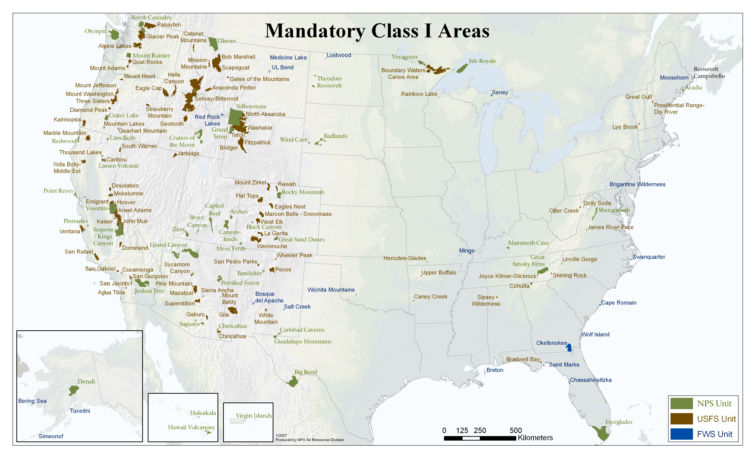




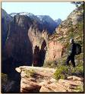
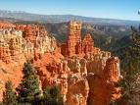

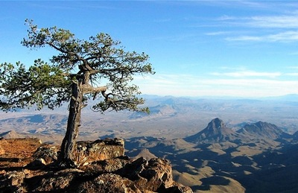
Track progress at 156(155) Federal Class I Areas
Notes:
2
156 national parks and wilderness areas where visibility was deemed an important attribute

Slide 3
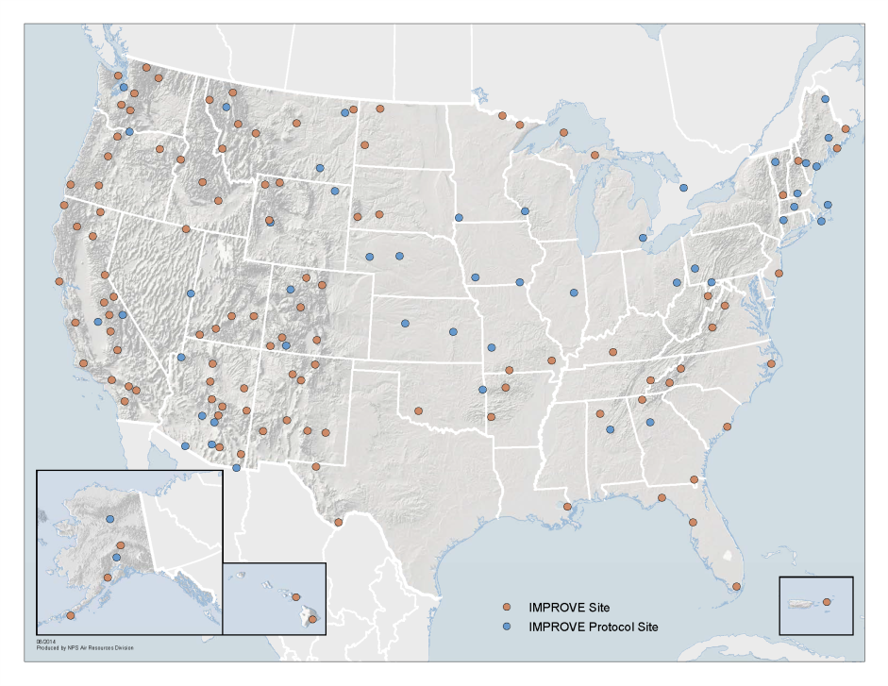
What is IMPROVE?
Interagency Monitoring of PROtected Visual Environments
It is a monitoring network and a group which makes recommendations about the network.
The network began in 1988 with 20 sites
Now ~163 sites representing
USDA FS, FWS, NPS, State,
Tribal, International agencies

Slide 4









Who is the IMPROVE Steering Committee?
Primary funding source
Contracting agency
Associate (non-voting) Members
Arizona DEQ, Environment Canada, and Republic of Korea Ministry of Environment

Slide 5
What does the Steering Committee do?
Meet annually to discuss the state of the network
Identify issues related to funding, analytical techniques, data handling, site operations, visibility science.
Make consensus recommendations about solutions.
Provides feedback to agencies regarding issues and solutions.
-> You can interact with the SC formally by contacting your SC Representative or informally by contacting any member of the committee.

Slide 6


What does NPS do in managing the sampling network contractor and delivery of data & analysis results?
Listens to Steering Committee recommendations
Directs subcontractors to perform work:
UC Davis is the central lab
DRI provides TOR/Carbon analysis
RTI provides ion analysis
Supports CIRA activities at CSU:
  Cooperative agreement enables:
    Applied visibility research
    Provides data, methodology, and program tracking access via IMPROVE, FED, WRAP TSS and other websites
    Publishes raw data, visibility metrics, periodic IMPROVE reports, and other visibility documents on its websites.

Slide 7
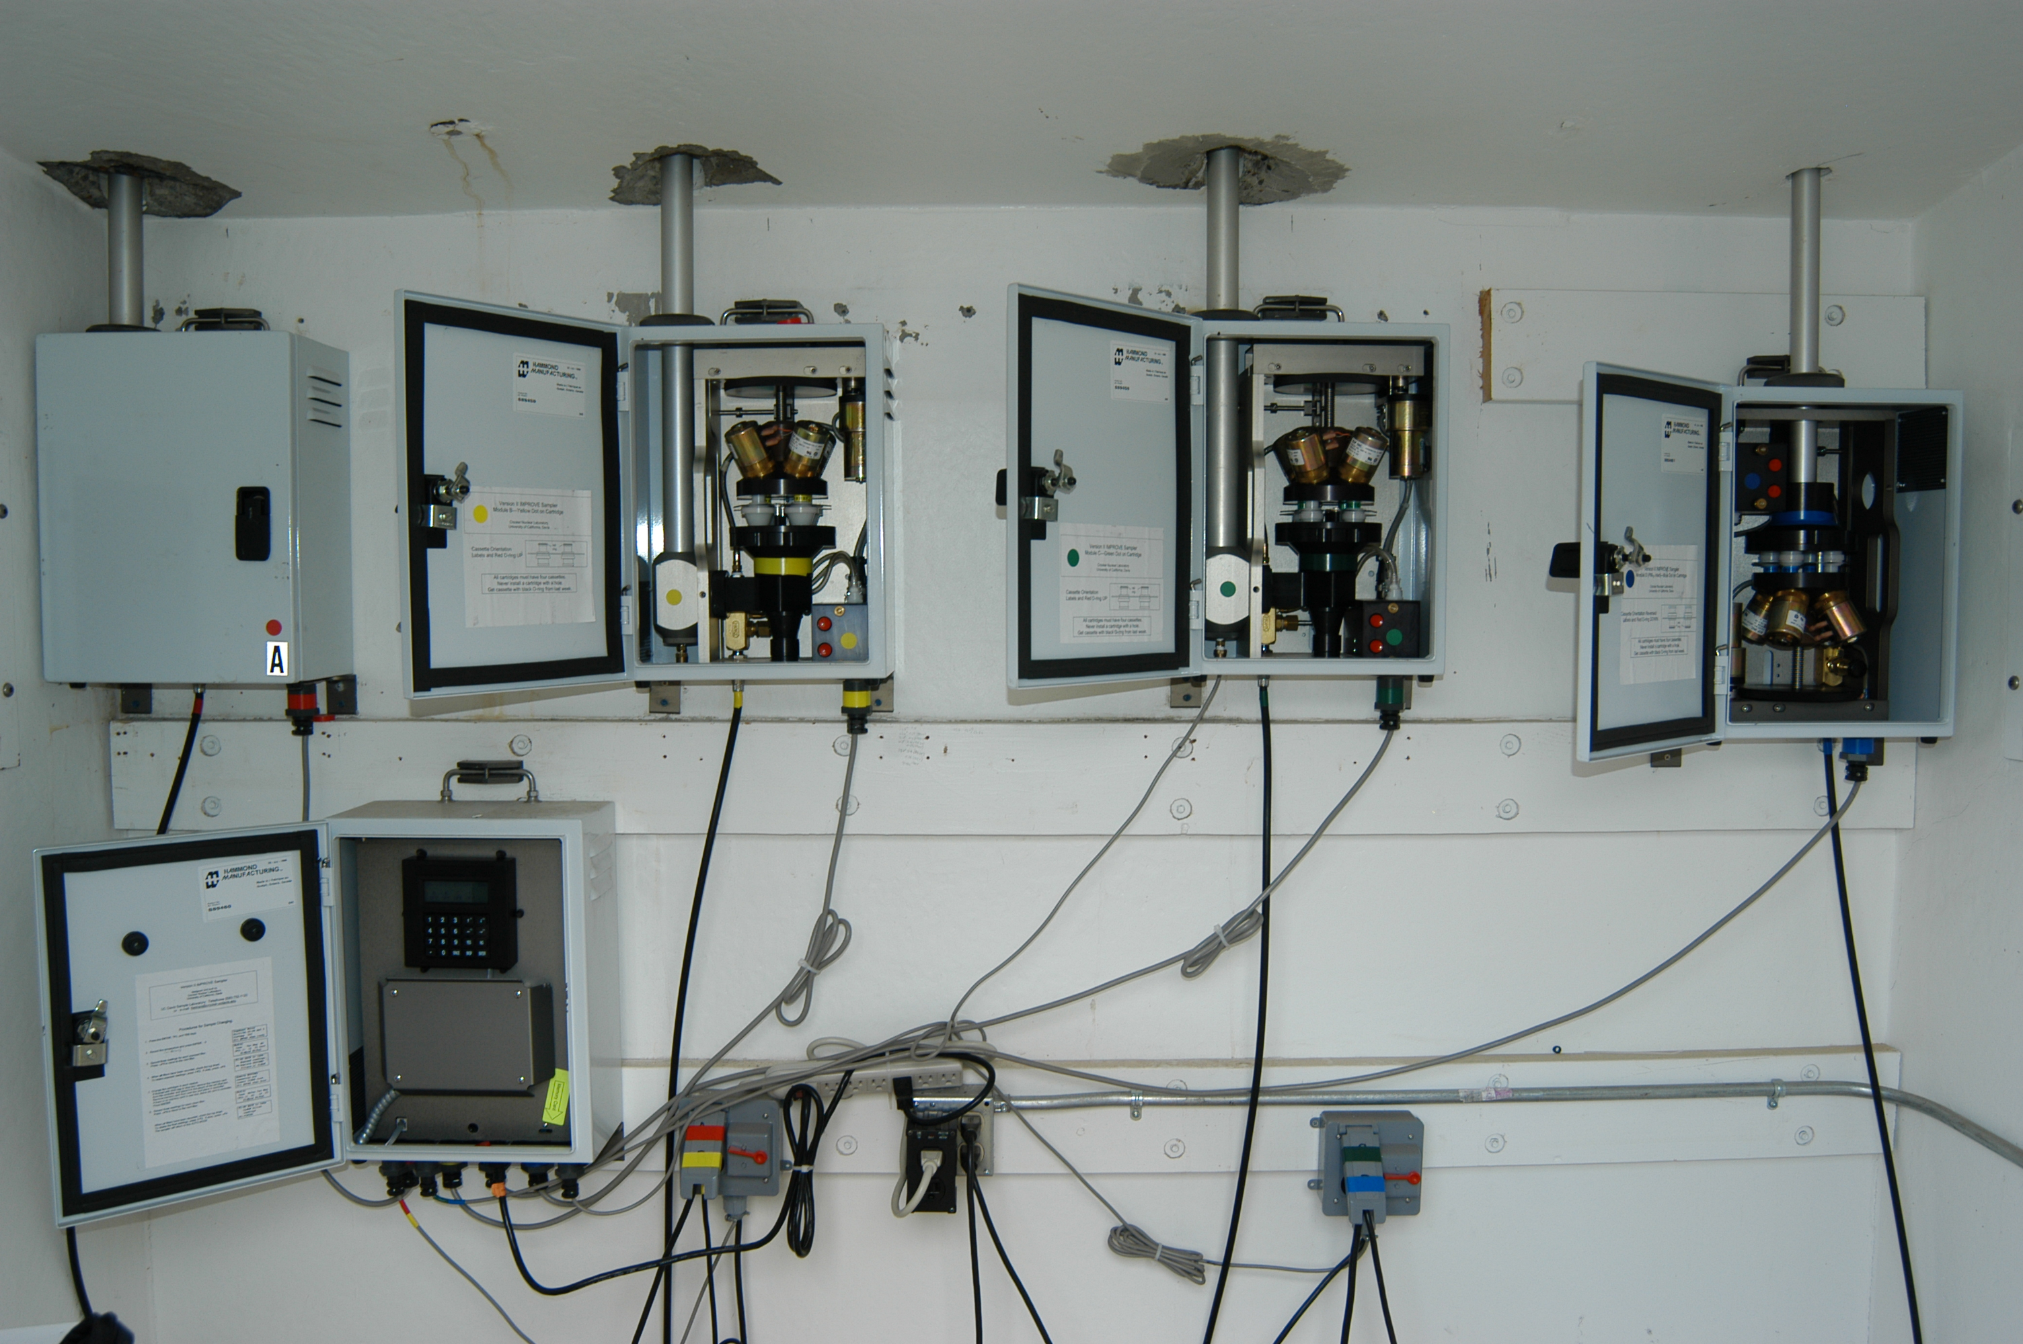
IMPROVE Aerosol Sampler(s) & Filter Analysis
Module A, PM2.5 Teflon
PM2.5 Mass (gravimetric, not FRM/FEM)
FTIR
Elements (XRF, PIXE, PESA)
Fabs (HIPS, BITS?)
Module B, PM2.5 Nylon
SO4=, NO3-, Cl-
Module C PM2.5 Quartz
OC, EC (TOR) (O1, O2, O3, O4, OP, E1, E2, E3)
Module D, PM10 Teflon
PM10 mass (gravimetric)

Slide 8
IMPROVE Site Selection for Regional Haze tracking
http://vista.cira.colostate.edu/improve/Publications/SOPs/UCDavis_SOPs/select22.pdf

Slide 9
IMPROVE Sampler Siting

Slide 10
IMPROVE Sampler Siting, cont.

Slide 11
Generate SS Rayleigh, f(RH) values for each new site.
12 monthly INAPM25-UCD-YYYYMM.txt files*
New Sites?
Yes
No
Natural Conditions 2 work based on pre-patched data if 3 in 5 year criteria met from 2000-2004.
Import UCD files, reassign site codes, change units, combine with f(RH) & SS Rayleigh values. (NEW: Perform Level 2 QA at CIRA. Add flags if necessary.)
Previous years’ data informs patching
Substituted values built from patched data. Substituted data used for NC2 if 3 in 5 year criteria not met from 2000-2004.
Run RHR2 patching algorithm, then completeness checks.
Species specific flags added for patching
Calculate RHR2 & RHR3 metrics.
Generate Pie Maps and rolling 5-year averages.
Post to FED and Google Drive*.

Slide 12
(current) IMPROVE Light Extinction Reconstruction “second” equation (used in Round 1 RHR planning)

Slide 13
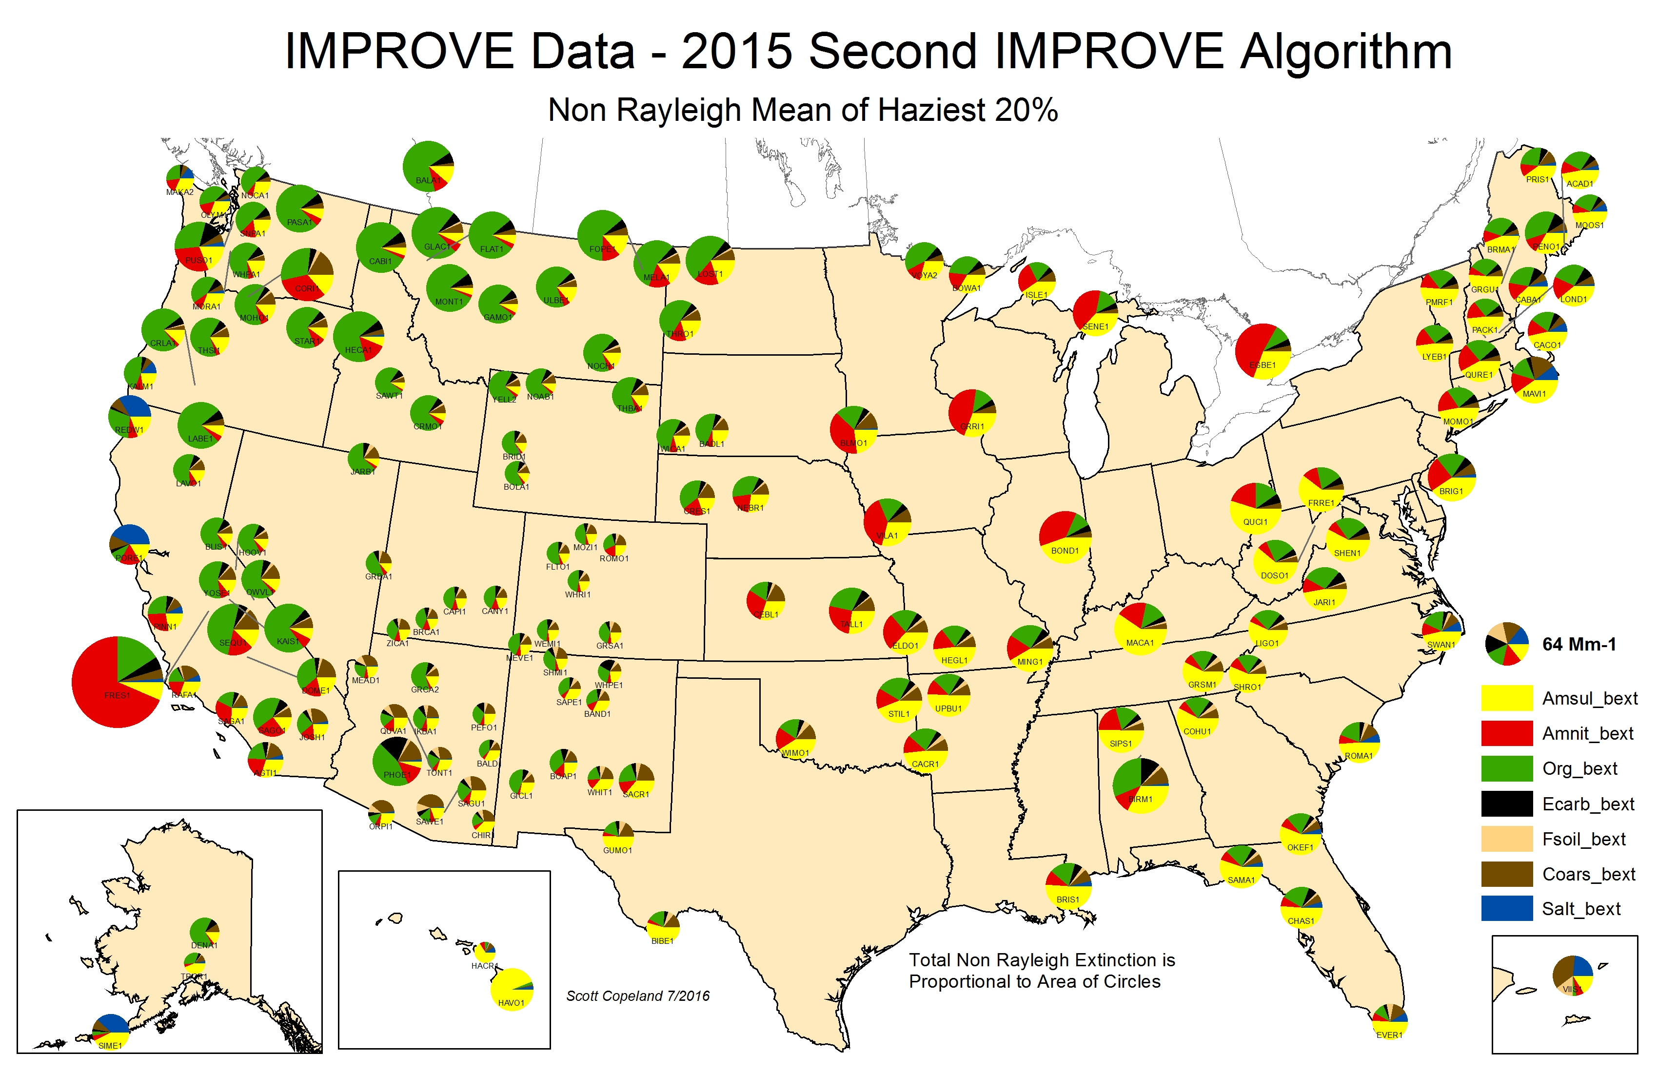

Slide 14
Main IMPROVE data websites:
http://views.cira.colostate.edu/fed/
  Data queries (for experienced analysts, lots of choices & details)
  Canned Graphics (draft impairment metrics)
  “RHR2” = Haziest 20% day RHR metrics.
  “RHR3” = my shorthand for “impairment metric” approach.
http://vista.cira.colostate.edu/Improve/
  “rolled up” results
  RHR2 annual metrics
  Entire IMPROVE data set – RHR2, daily
  Winhaze
  Key documents:
    Steering Committee meeting notes and presentations
    QAPP
    Data Advisories
Not direct sources of Regional Haze planning data

Slide 15
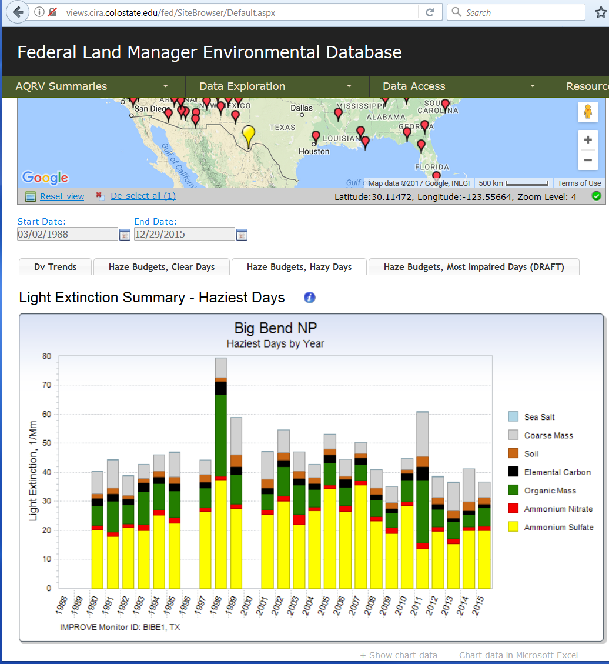
RHR Baseline

Slide 16
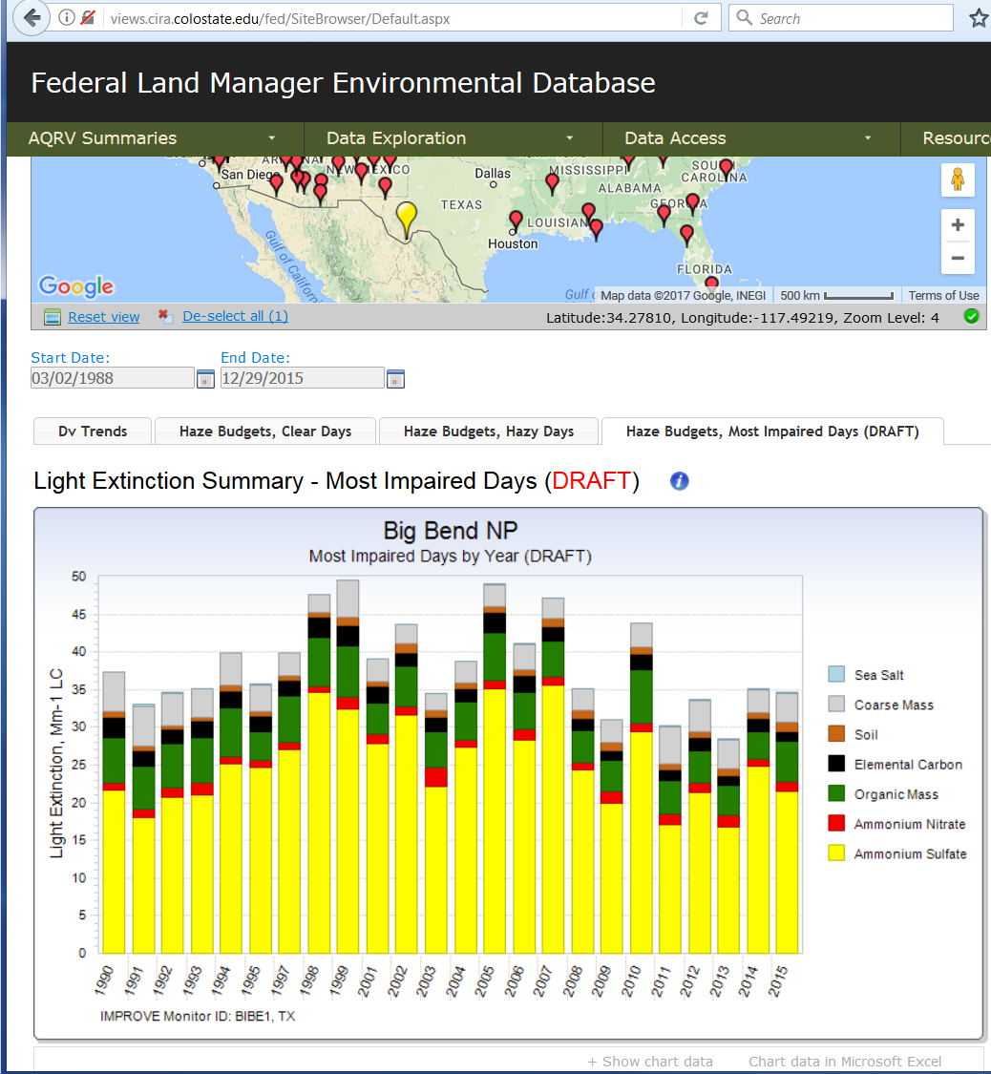
RHR Baseline

Slide 17
Closing comments:
2016 IMPROVE data will be delayed, likely until roughly November.
-Delay should be shorter for 2017 data.
EPA’s final impairment guidance document release date is uncertain.
I am working on adding substituted data to the Impairment Approach dataset, and then reproducing the 2064 endpoint values from the guidance.
Feel free to contact me with questions and comments.

Slide 18
Questions?

